Slide 1
Midnight’s Café Created by: Daniella Luzi Team Name: Marshall and Company

Slide 2
Application Scenario + Problem Statement
I spend a lot of time at cafés, and I love to try different drinks they offer!
This can be modified to deal with fast food, retail, etc.
My past Python and SQL projects were based around cafés/food, so I wanted to carry that over into Java.
Can give a brief overview of how ordering online works.

Slide 3
How Program Works and Method
This program allows you to order drinks from a café and then prints out a receipt. There are 6 options to choose from, and there is no limit to how much you may order. It also includes a button to reset your order if a mistake was made. The receipt includes the quantity of each item, the price, the total, your reward level based on how much spent, the employee’s name and ID number, as well as a QR code that takes you to our website.
I started by drawing out on paper how I wanted the UI to look and then started with the basics (a window with a title, for starters). I worked on one window at a time before moving to the next one. I put the finishing touches on last (background colors, QR code website, ensuring everything was running).

Slide 4
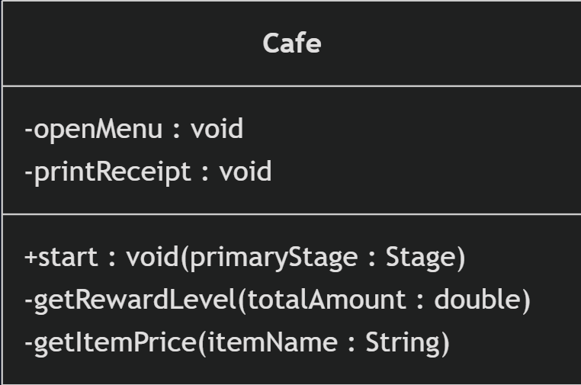
UML Diagram

Slide 5
What I Learned
JavaFX in detail/more hands-on experience
ImageView, HBox and VBox, Region, etc.
Trial and Error
Starting small and building up
Time Management

Slide 6
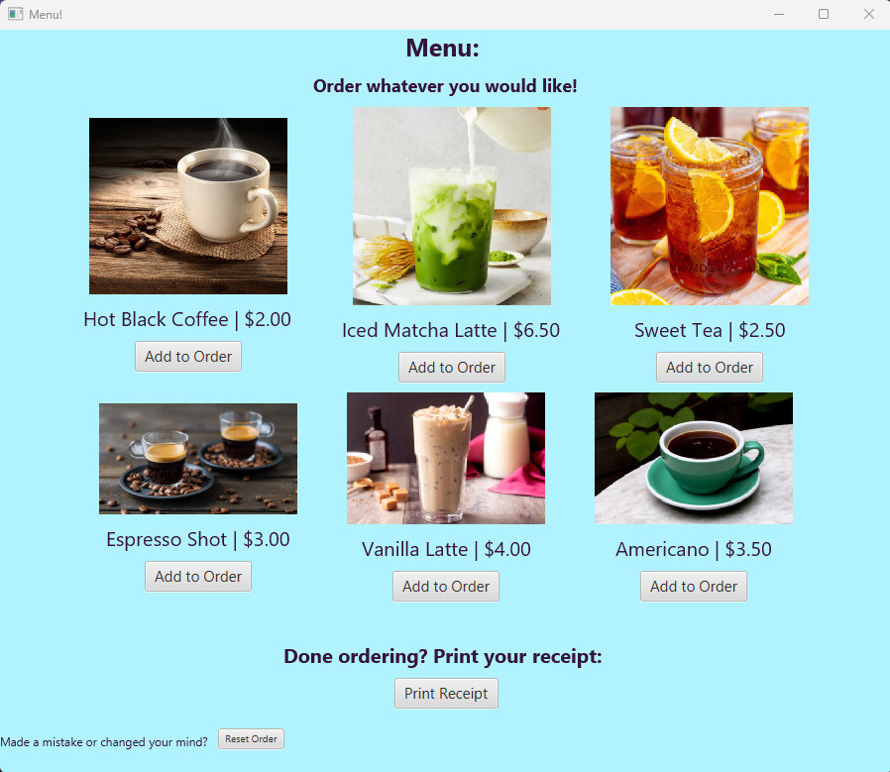
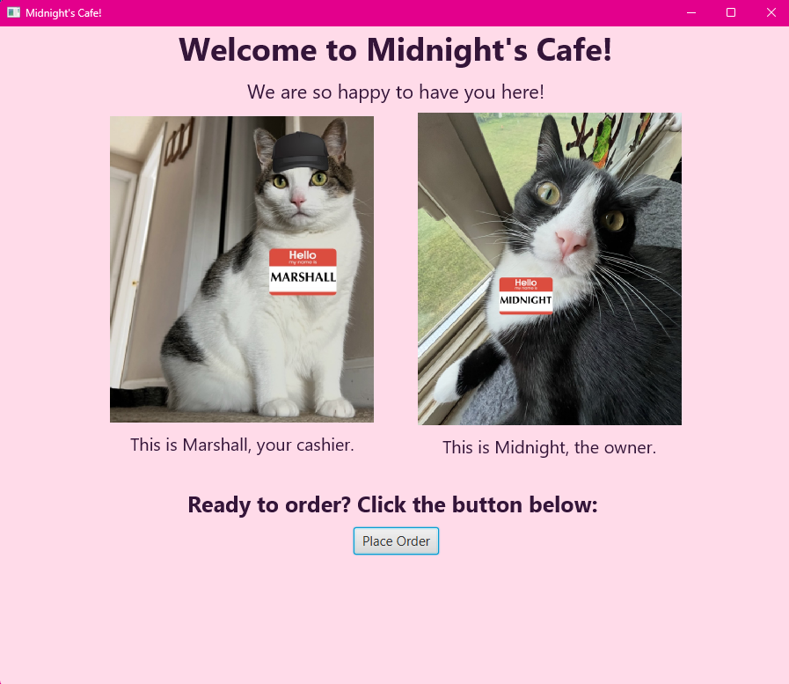
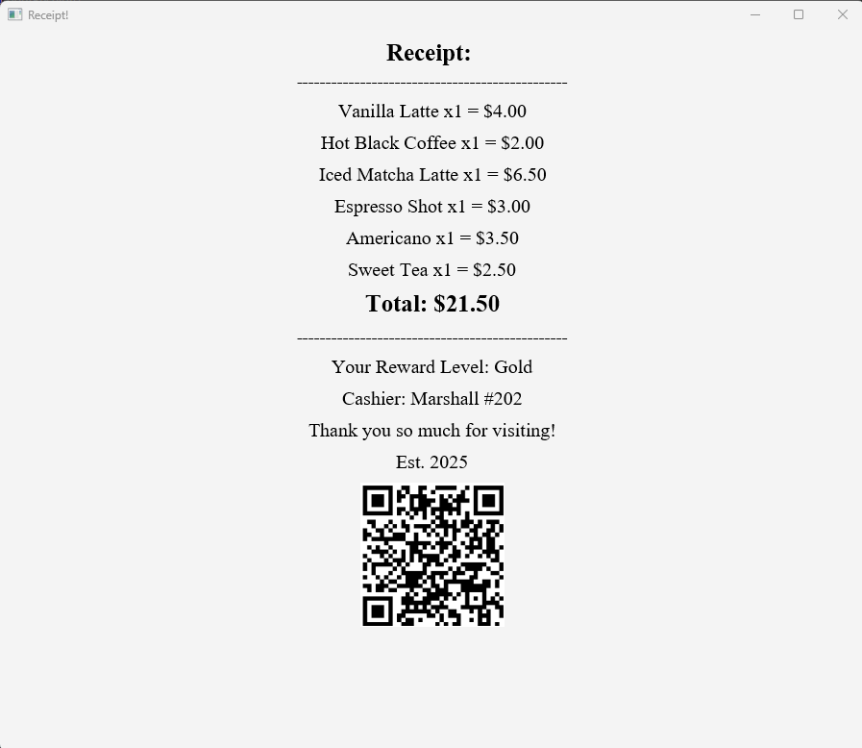
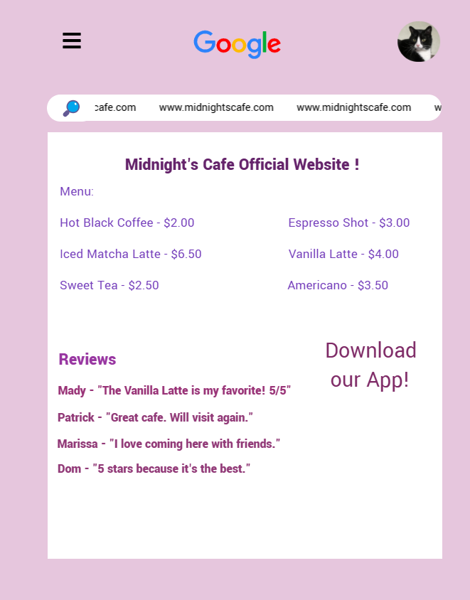
Sample Demo
2nd Window
1st Window
3rd Window
Website from QR Code!

Slide 7
Works Cited
Brandie. “Southern Sweet Tea.” The Country Cook, 3 June 2024, www.thecountrycook.net/southern-sweet-tea/comment-page-2.
“Creamy Caramel Iced Vanilla Latte + More Iced Coffee Drinks With 100 Calories or Less.” Hungry-Girl, 5 Aug. 2021, www.hungry-girl.com/weekly-recipes/caramel-vanilla-latte.
Donofrio, Jeanine. “Iced Matcha Latte.” Love and Lemons, 27 July 2023, www.loveandlemons.com/iced-matcha-latte.
Matt Taylor-Gross. www.matttaylorgross.com/index/all.
“Pavel Korotkov.” Adobe Stock, stock.adobe.com/contributor/206678165/pavel-korotkov?load_type=author&prev_url=detail.
Shutterstock. www.shutterstock.com/image-photo/espresso-150000692.
Strawpage, straw.page.

Slide 8
Demonstration Time!

